Slide 1
Lead Scoring Case Study
By Priya KM &Vaibhav Kamble

Slide 2
Lead Scoring Case Study:
Problem statement:-
X Education, an online course provider, seeks assistance in identifying the most promising leads with the highest likelihood of converting into paying customers. The objective is to assign lead scores to prioritize leads, ensuring those with higher scores are more likely to convert, aligning with the CEO's target conversion rate of around 80%.

Slide 3
Lead Scoring Case Study
Analysis approach:-
Understanding Data
Data Cleaning
Data Transformation
Dummy Variables Creation
Train
Test
Model Building

Slide 4
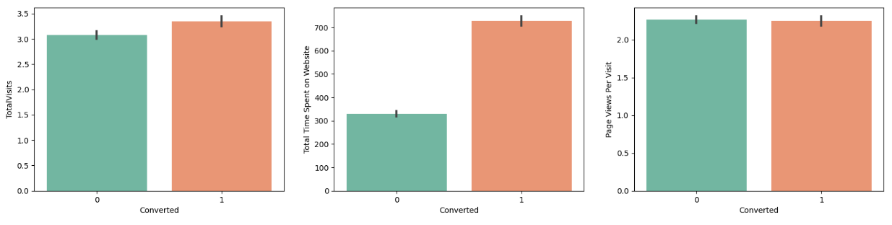
Lead Scoring Case Study
The conversion rate tends to be higher for leads with higher values in Total Visits, Total Time Spent on Website, and Page Views Per Visit.
With all the data labels in good shape, we can proceed to the next step, which is Data Preparation.

Slide 5
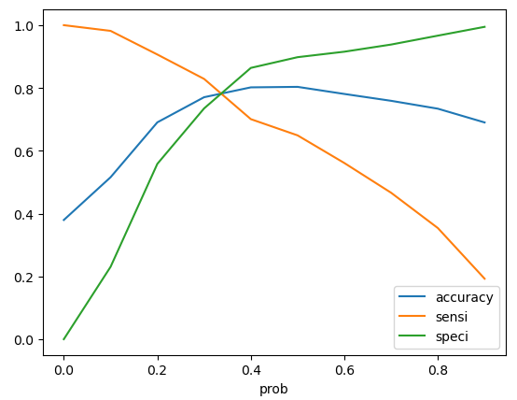
Lead Scoring Case Study
Evaluation matrix
Measures | Train set | Test set
Accuracy | 77.05% | 77.52%
Sensitivity (No. of correctly predicted YES) | 82.89% | 83.01%
Specificity (No. of correctly predicted NOs) | 73.49% | 74.13%
Gini (ROC curve area) | 0.86
The optimal predicted probability for a customer being converted is 0.35.
The model has good accuracy, sensitivity and specificity.
There is a balance among accuracy, sensitivity and specificity

Slide 6
Lead Scoring Case Study
Model Building
Recursive Feature Elimination was used to select the top 15 important features
Significance of features was determined based on P-values, with insignificant variables dropped.
The final model comprised 11 significant variables with satisfactory VIF scores.
Optimal probability cutoff was determined through ROC curve analysis, yielding an area under the curve of 86%.
Model accuracy, sensitivity, and specificity were assessed, achieving satisfactory results.
Precision-recall trade-off led to a cutoff value of approximately 0.3.
Learnings from the train set were applied to the test set, resulting in a conversion probability accuracy of 77.52%, sensitivity of 83.01%, and specificity of 74.13%.

Slide 7
Lead Scoring Case Study
Summary
The final predicted model achieved a conversion rate of 83% on the test set, meeting the CEO's target.
The model's good sensitivity ensures the selection of promising leads.
Key features contributing to lead conversion probability include –
Lead Origin_Lead Add Form.
Working Professional occupation.
Total Time Spent on Website

Slide 8
Thank You..!

